Slide 1
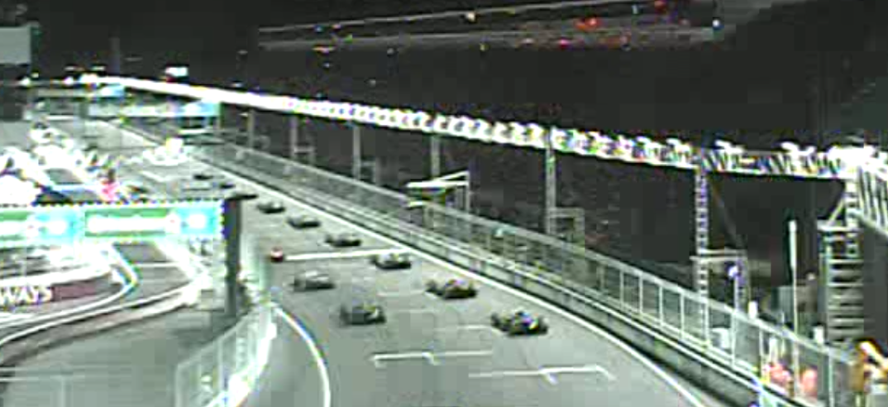
Formula 1 & Special Events
Theresa Gaisser, PE, PTOE
Senior Director of FAST
Notes:
Good morning ITE.
Good Afternoon, I am Theresa Gaisser with the Regional transportation Commission of Southern Nevada. I am the Senior Director of the FAST Traffic Management Center. In our role, as regional traffic manager, we oversee the freeway and arterial operations in Southern Nevada, including incident management, construction and special event coordination.
FAST operates and maintains the Southern Nevada traffic system on behalf of the state and local agencies, who are the owners of the equipment, which includes:

Slide 2
Las Vegas by the Numbers
Notes:
Annually,
2 Million Residents
42 Million Visitors
6 Million convention attendees

Slide 3
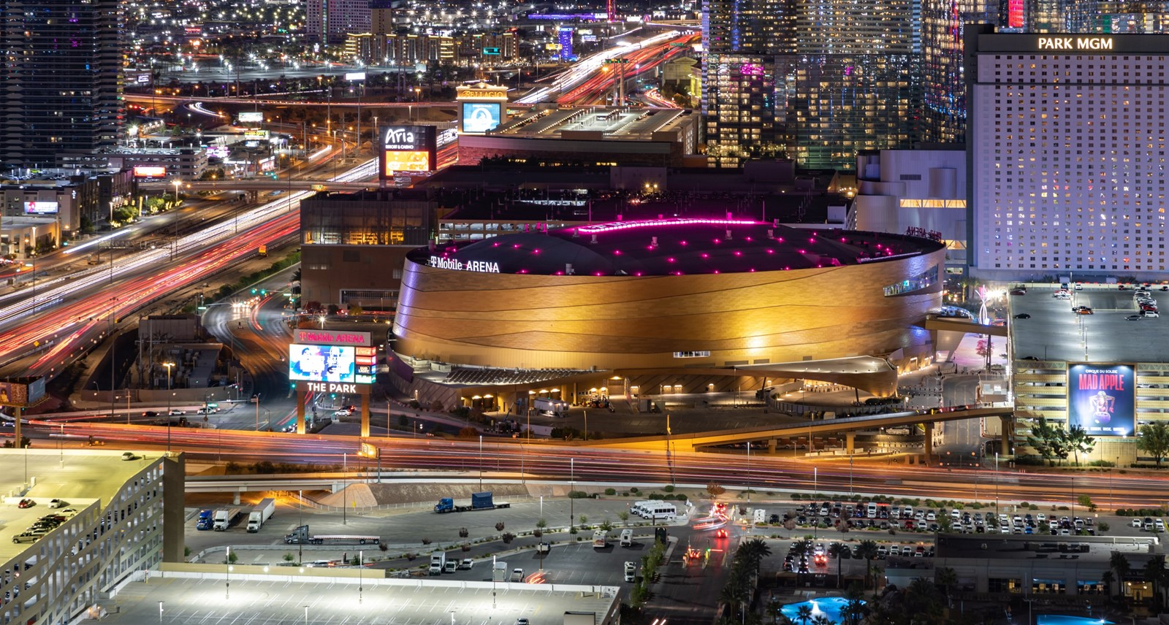
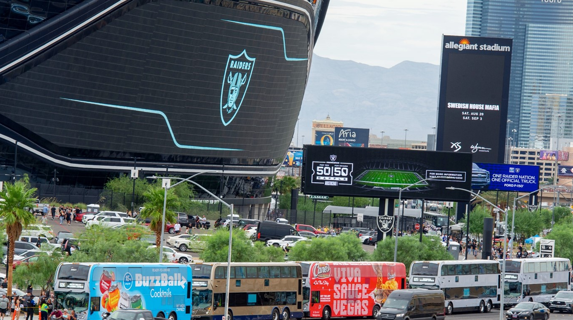
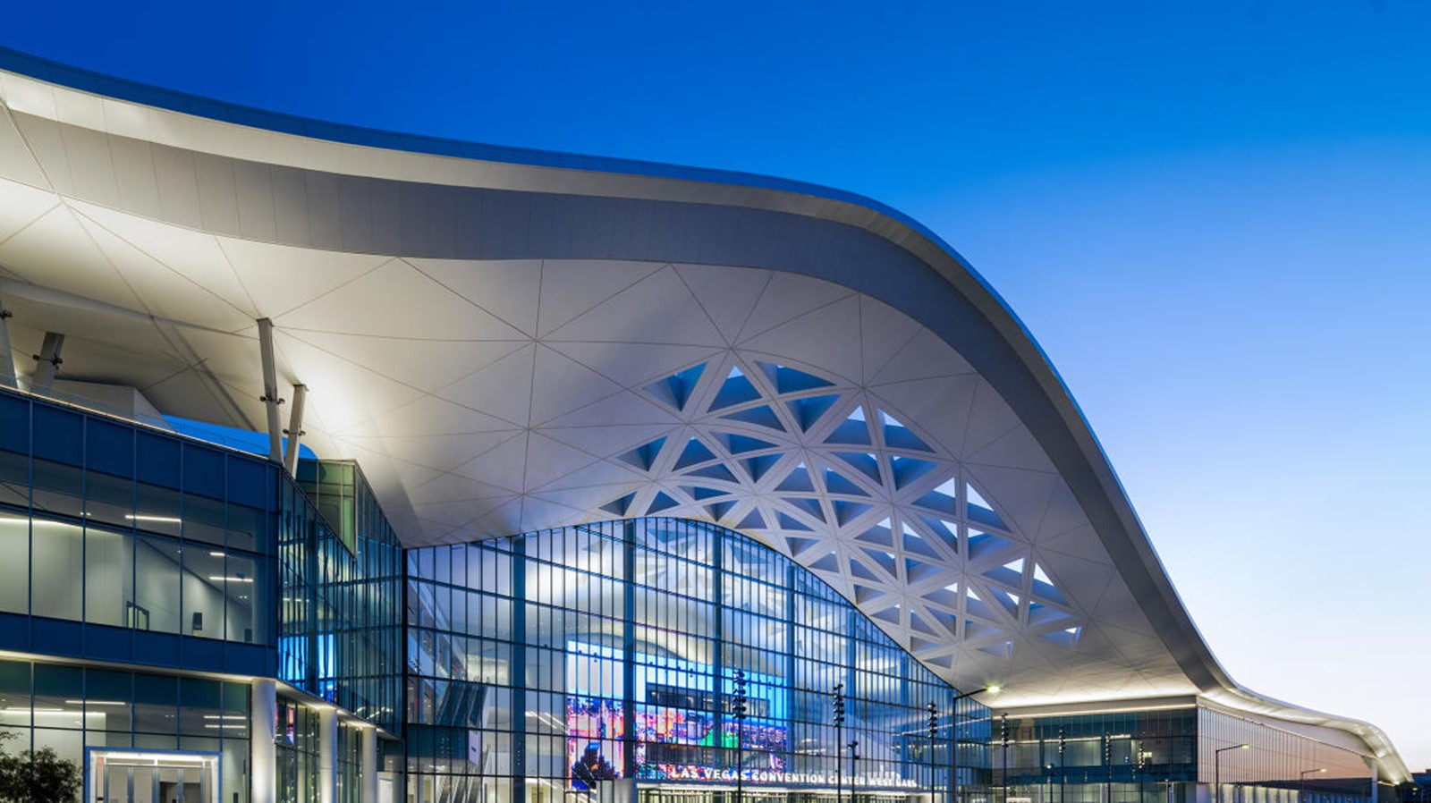
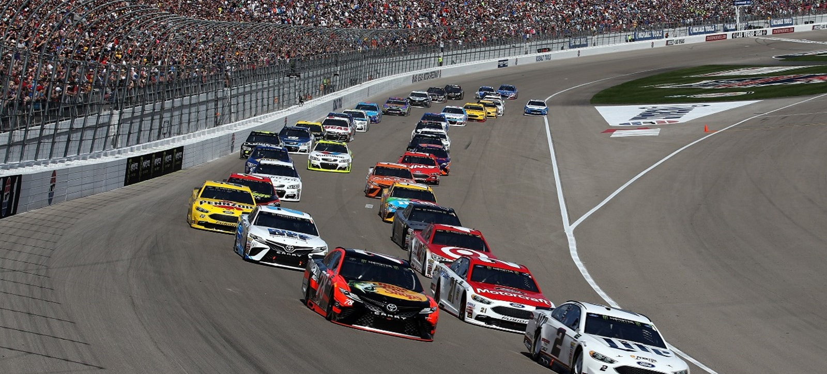
Major Venues
Las Vegas Motor Speedway
Las Vegas Convention Center
T-Mobile Arena
Allegiant Stadium
Notes:
As part of the FAST roles and responsibilities, we also work closely with partner agencies to manage traffic in and around other large-capacity venues like T-Mobile Arena, Allegiant Stadium, Las Vegas Motor Speedway, and the Las Vegas Convention Center.
We have several large-capacity venues like T-Mobile Arena, Allegiant Stadium, Las Vegas Motor Speedway, and the Las Vegas Convention Center.
Allegiant Stadium – 65K fans for the Las Vegas Raiders
LV Motor Speedway – 150,000 per night for EDC
LV Convention Center – 150,000 each day for CES

Slide 4
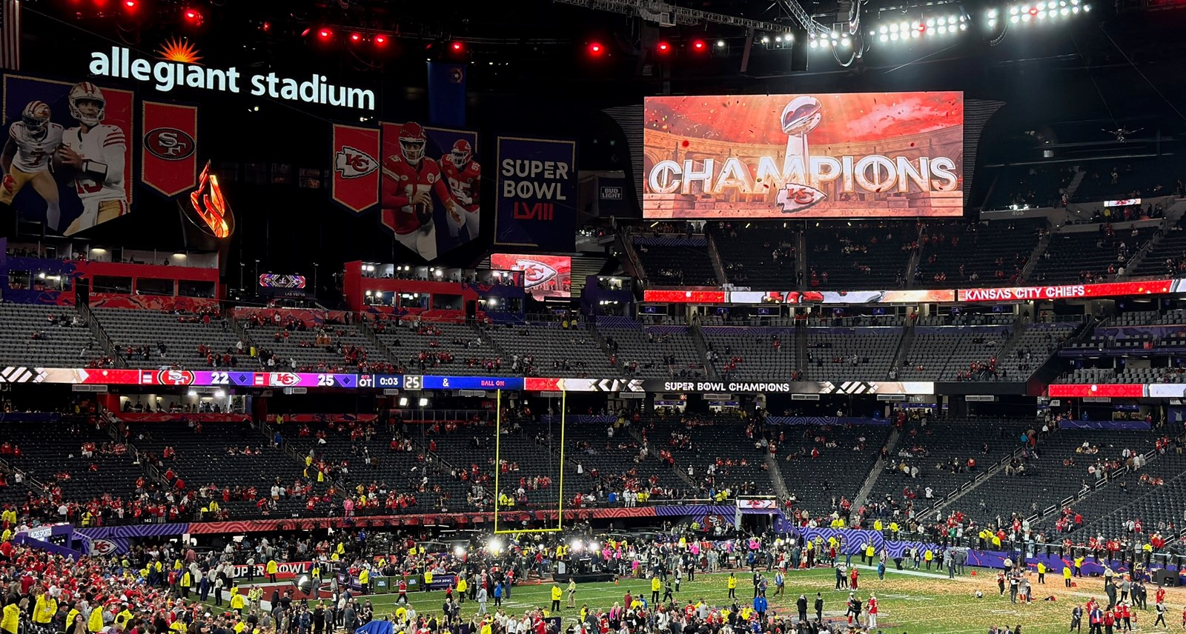
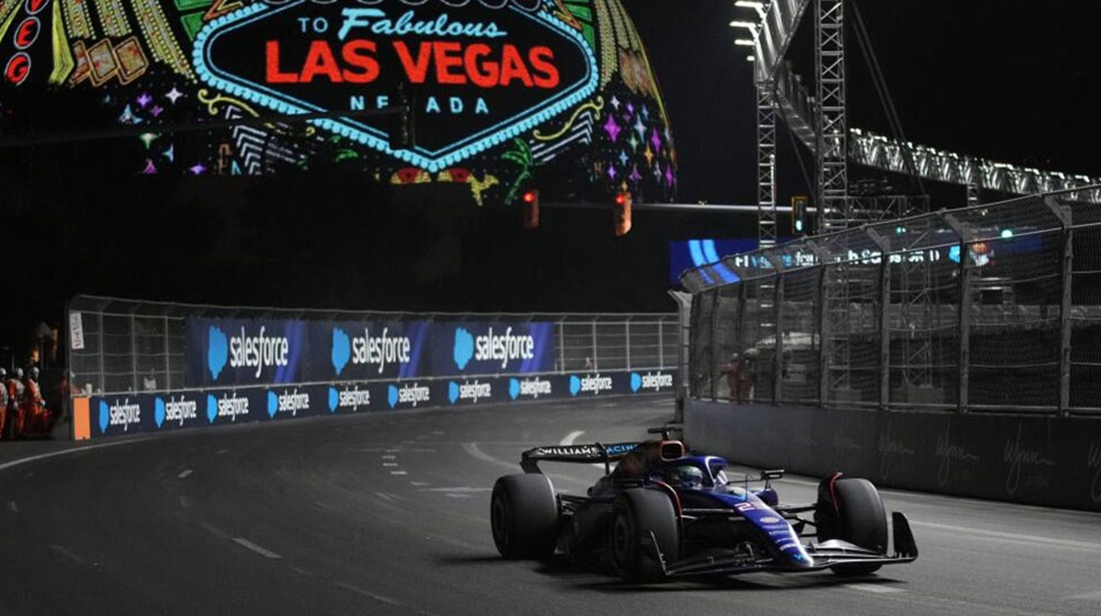
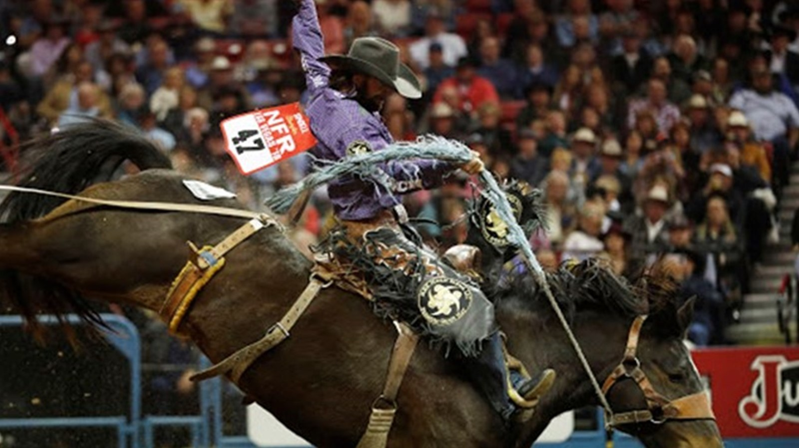
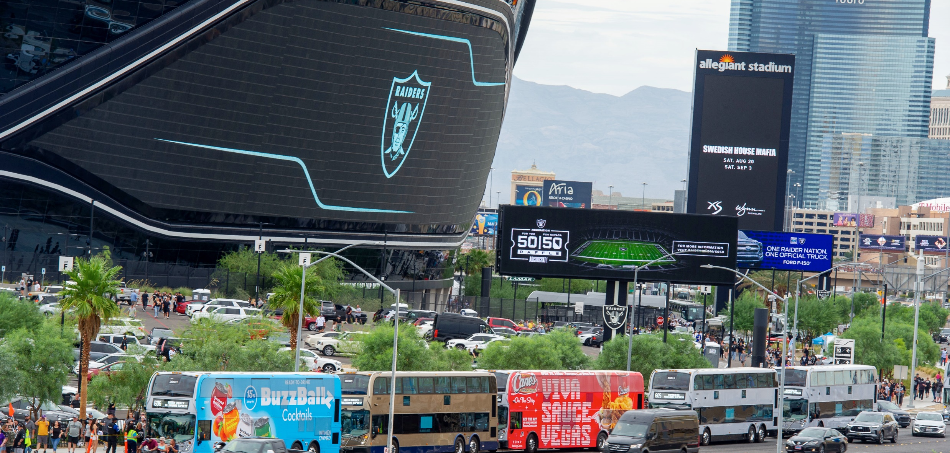
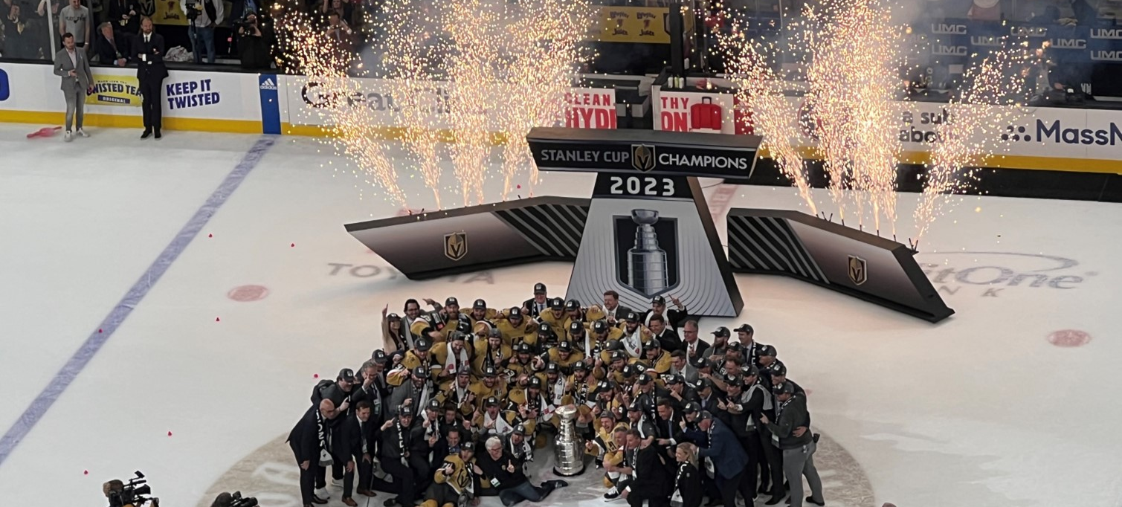
Special Events
NFR – National Finals Rodeo
Raiders NFL Football
F1 – Formula One
Vegas Golden Knights Hockey
Super Bowl
Notes:
Additionally, in November of 2023 we hosted our 1st Formula One Las Vegas Grand Prix, with the race occurring on our public roads, including Las Vegas Blvd.
In Feb 2024 we hosted the 1st Las Vegas Super Bowl.
Major events this year included Consumer Electronics Show, Electric Daisy Carnival, the Formula 1 Las Vegas Grand Prix Race, and the 1st Las Vegas Super Bowl
FAST tracked 932 major special events, actively worked 304 events, and prepared and programmed signal timing for an additional 159 events in 2023.
Just to name a few…
Life is Beautiful
EDC – Electric Daisy Carnival
CES
VGK Hockey
Nascar
Raiders Football
National Finals Rodeo
New Year’s Eve
NHL Stanley Cup Playoffs and Championship Parade
Formula 1 Las Vegas Grand Prix Race
SuperBowl 58
Upcoming… NHL Draft

Slide 5
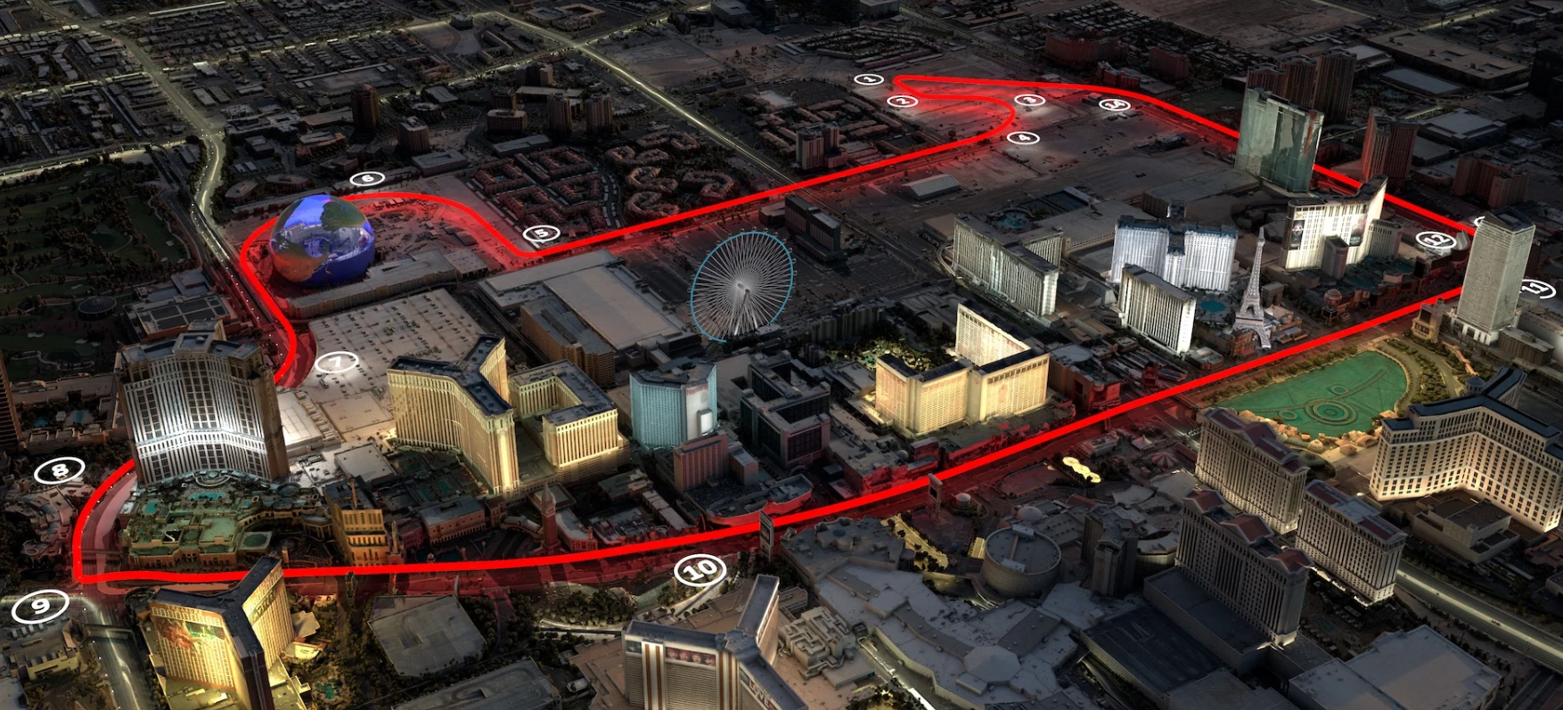
Race
Track
Notes:
Track Construction began in April 2023 for the November 2023 race.
Course includes Harmon, Koval, Sands and Las Vegas Blvd.
Full depth pavement and sub base was required a construct this high speed course.
Then track lighting, barriers, safety fencing, vehicular and pedestrian bridges were built off site, and moved into place.
Massive public outreach, especially with F1 and resort employees, since the track essentially created an island surrounding many hotel resort properties.

Slide 6
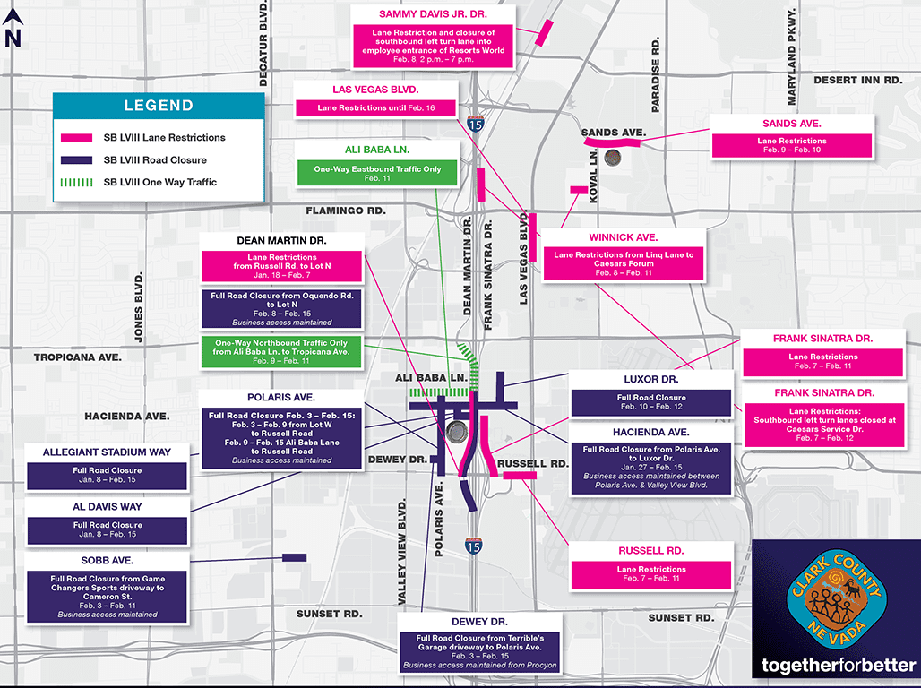
Event Preparation
Run of the Show
Road Closures
Concurrent Events
Signal Plans
Notes:
Talk to other locations that have hosted previously
For the Formula 1 Race alone, the FAST team:
Participated in 75 meetings
Reviewed over 100 plan sets
Provided 5 days of continuous staff coverage for this event
For Super Bowl:
We were part of the Las Vegas Super Host Committee, and attended meetings for over 1 year, to capture all of the planning data
Speak up and ask for specific working meetings if necessary
Detailed Run of the Show
All known road closures
All known construction, and will any construction be halted for the event
Concurrent Events???
In places other than known venues? Parking lots? Parks?
Prepare your signal plans in advance
Draft all DMS messages if Committee approval is required
Attend all meetings, including meeting minutes
Coordination is your best asset

Slide 7
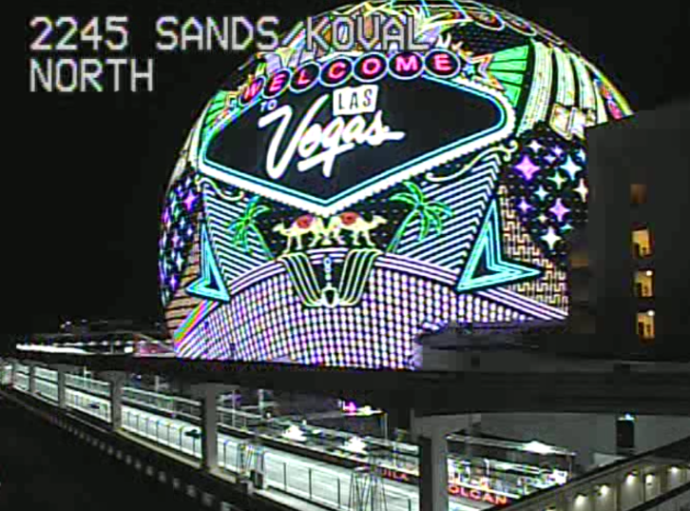
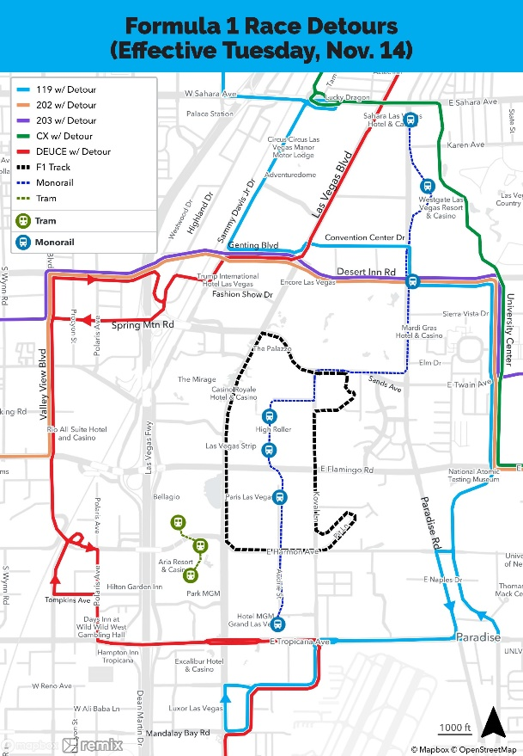
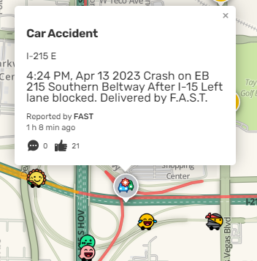
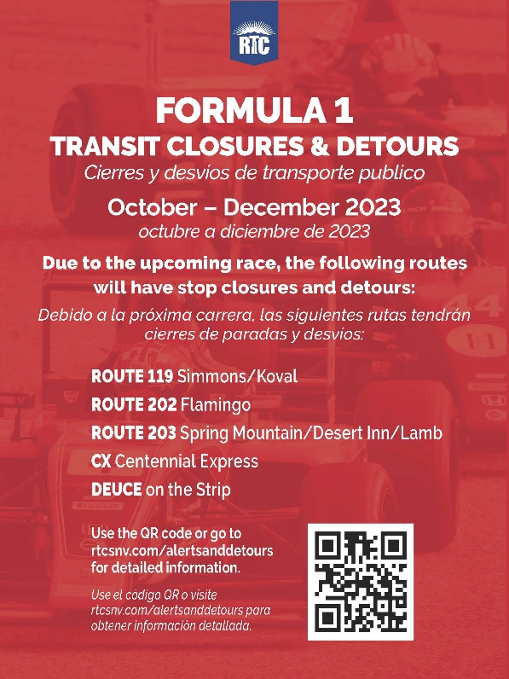
Technology
Notes:
Technology Equipment and facility needs:
We do have a fully functional traffic management center inside the stadium so we can communicate directly with stadium security and operations staff.
Clark County has also upgraded the signal around the stadium with communication equipment so we can take manual control when necessary to safety move thousands of people and vehicle before and after events.
As the “Entertainment Capital of the World” Las Vegas has continued to expand its offerings including major sporting events, in 2020 the RTC created the Regional Events Traffic Management meeting to coordinate with venues, agencies, first responders, traffic control companies, and law enforcement to better understand the regional impacts of multiple events at various venues.
Need to use technology to get the message out to the public:
Multi-agency coordination meeting
Press Releases
Agency Point of Contacts/ Communications Plan
Concurrent Events
Google
• WAZE App
• Email Blasts
• Social Media
• Text Messaging
• DMS Signs
Will there be a Unified Command Stood Up?
Will there be an Emergency Command Center stood up? Our here we have the MACC, the Muliti-agency Command Center
Talk to other locations that have hosted previously
Talk to navigation apps
Parking Lots/ Uber/ Lyft/ Shuttles/ Transit/ Monorail
On-going Construction
Alternate Routes
Employee Access
Traffic Signals
Time of Day Plans
Develop Ingress/Egress Plans
No 2 events are exactly alike
Consider Pedestrian Exclusive Traffic Signal Plan
Proactively manage safety (reduce weaving):
Shut down adjacent on-ramps during ingress
Shut down adjacent off-ramps during egress
Split phase traffic signal operations

Slide 8
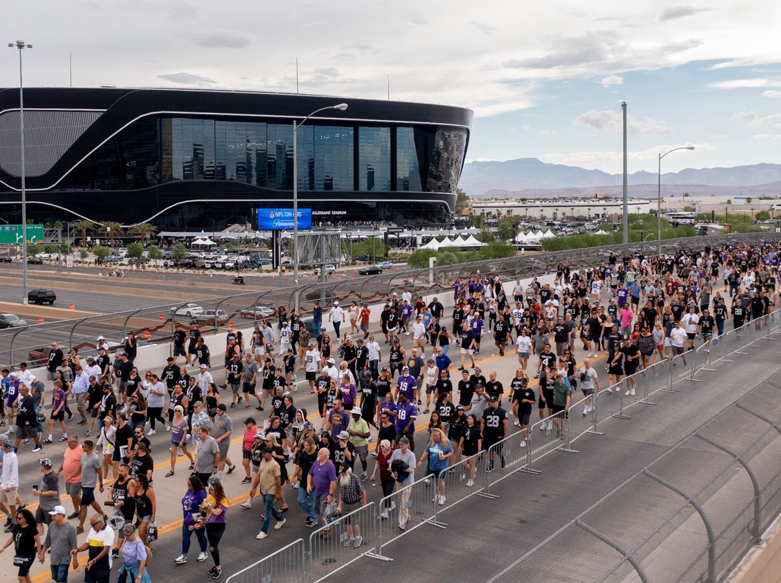
Event Day
Run of the Show
Traffic Alerts
Dynamic Message Signs
Signal Plans
Notes:
All Hands on Deck
Better to have staff, and then pair down
Work the Run of the Show PLAN!!!!!
Everyone on the same sheet of music
Run of the Show
Traffic Alerts
DMS/ATM
Implement Signal Timing Plans
Observe the Traffic
Manage the Unknowns
Expect the Unknown
Will Taylor Swift’s plane arrive on time?
Will there be public protests?
Weather?

Slide 9
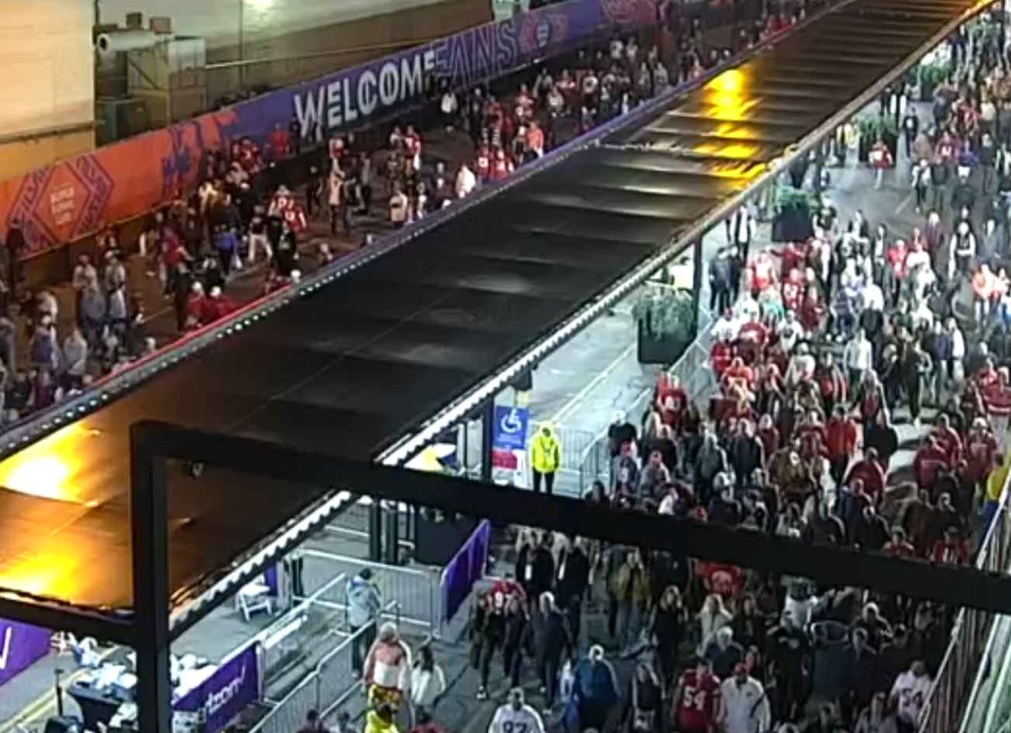
Debrief
What went well?
What didn’t?
Lessons learned
Best practices
Notes:
Schedule a debrief for immediately after the event, one internal , and one with external partners
A complete and comprehensive schedule of activities provided to all supporting partners is critical, including set-up, event days, and dismantle, prior to the work ever beginning.
How close to the event Traffic Management Plan or traffic study was the reality?
Lessons learned have a plan, practice the plan frequently, never hesitate to enact the plan and stand up emergency response, even virtually. Work with your state officals to be ready to to expand emeregency response months in advance. It’s easier to reduce then to add.
These events are shifting the modes of transportation previously seen in Vegas.
Looking forward to Brightline High Speed Rail, which will hopefully reduce vehicle congestions on I-15, and encourage visiortos to look for options to signle passenger vehicles
Talk to other locations that have hosted previously
Coordination is key
Co-locate on event days as much as possible to expediate the flow of information

Slide 10
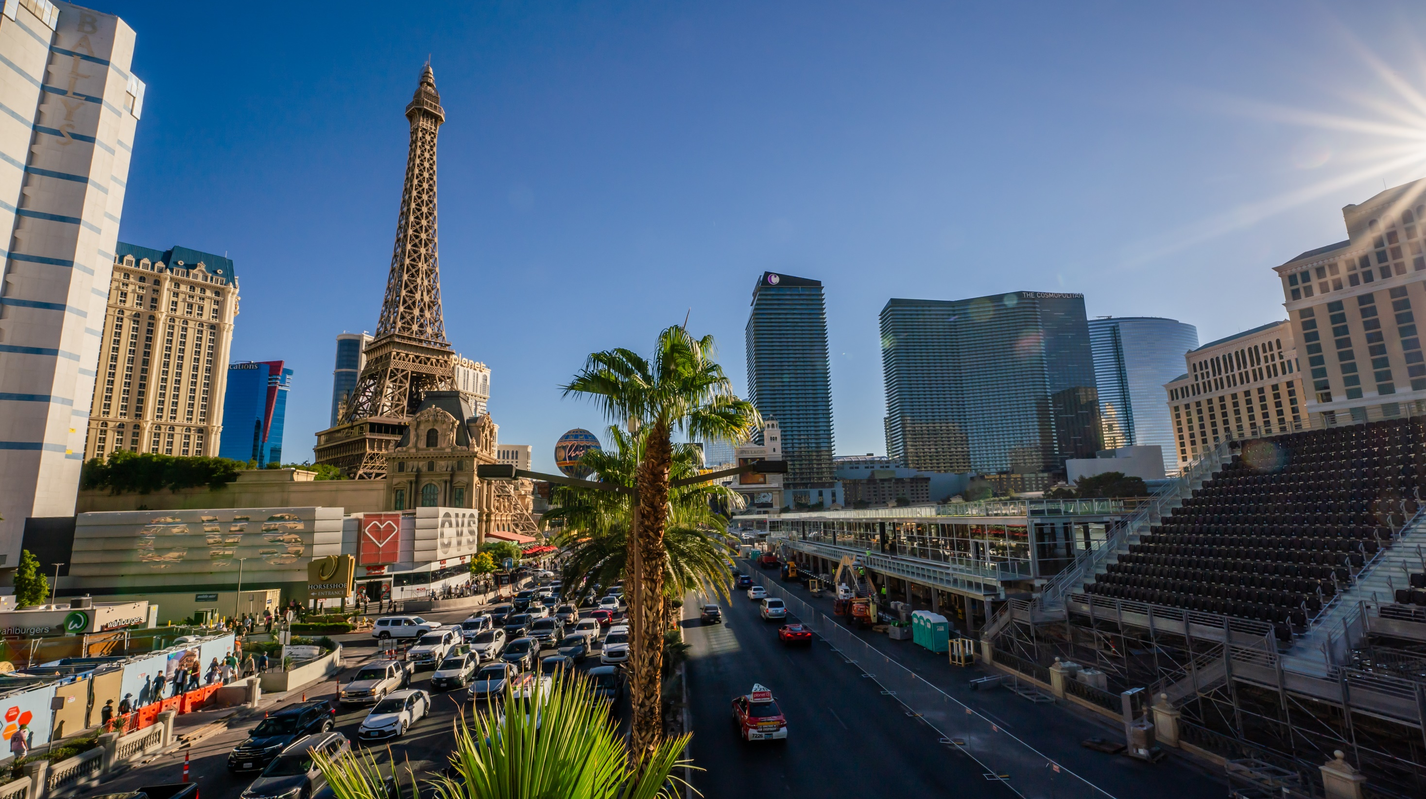
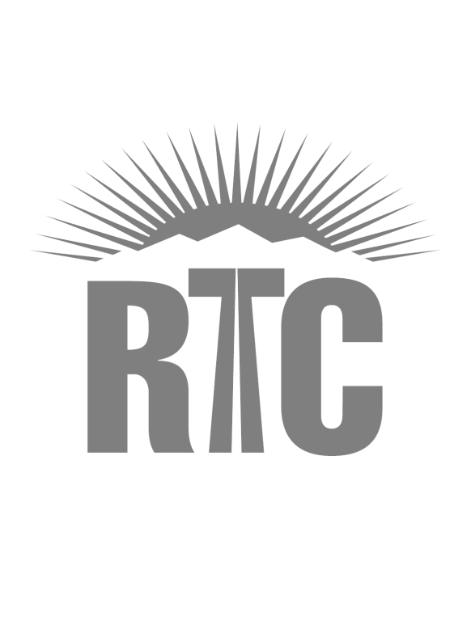
Theresa Gaisser, PE, PTOE
Senior Director of FAST
Notes:
Thank you. That concludes our presentation. We’d be happy to take any questions you may have.
For more information, please visit our website.

